Slide 1

Build a web scraper based on virtual threads!
@David_Vlijmincx
www.davidvlijmincx.com | Oracle ACE

Slide 2
Outline
Set up
Threads and virtual threads
Thread performance (How fast can you scrape)
Structured concurrency
Scoped values
Bonus features ☺ (Diving deeper into the details)
Show your Scraper/ freestyle assignments (If you want)

Slide 3
What is a web scraper
A bot
Downloads web pages to find new web pages
GOTO 1

Slide 4
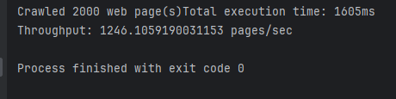
What is a web scraper

Slide 5
Set up of the workshop
The repo will have a README with assignments
Every assignment has its own starter branch with the same name
For each assignment we will go through this loop:
While(thisFormatIsOke)
Small presentation
Time to code!
Small demo

Slide 6
Time for step 1: Project setup

Slide 7
Set up
SSID: ---
WIFI password: ---
What You need:
https://github.com/davidtos/virtual_thread_workshop
IDE
Java 21
ChatGPT use at your own risk

Slide 8
(Platform) Threads
var thread = new Thread(task); thread.start();
var executor = Executors.newFixedThreadPool(
Runtime.getRuntime().availableProcessors()
)

Slide 9
Time for step 2: Adding threads

Slide 10
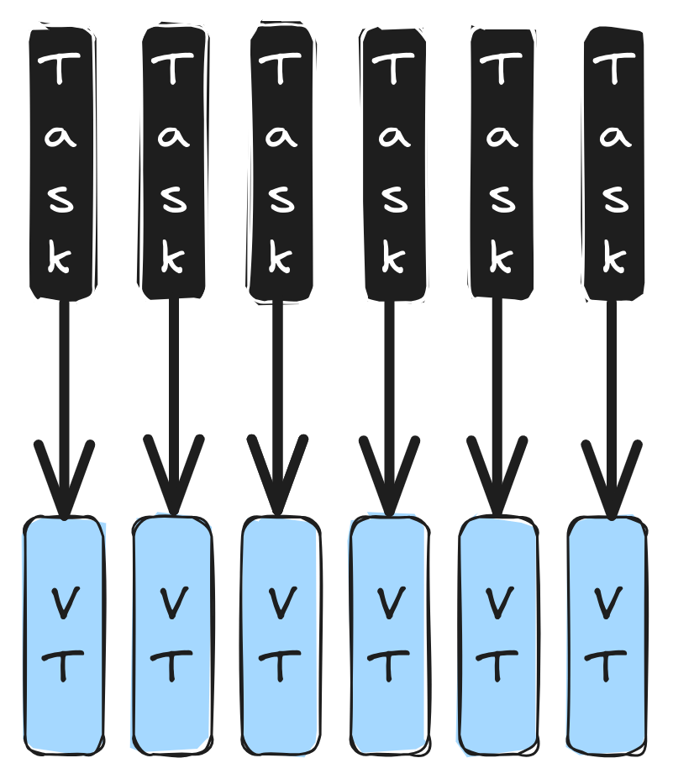
Virtual Threads
Alternative implementation of Threads
The OS does not know about them
Concept inside the JVM
Stack frames live on the heap
Resizable stacks
You don’t have to allocate a lot of memory at the start
Cheap to create

Slide 12
Virtual Threads
Thread.startVirtualThread(RunnableTask);
Executors.newVirtualThreadPerTaskExecutor()

Slide 13
Time for step 3: Virtual threads

Slide 14
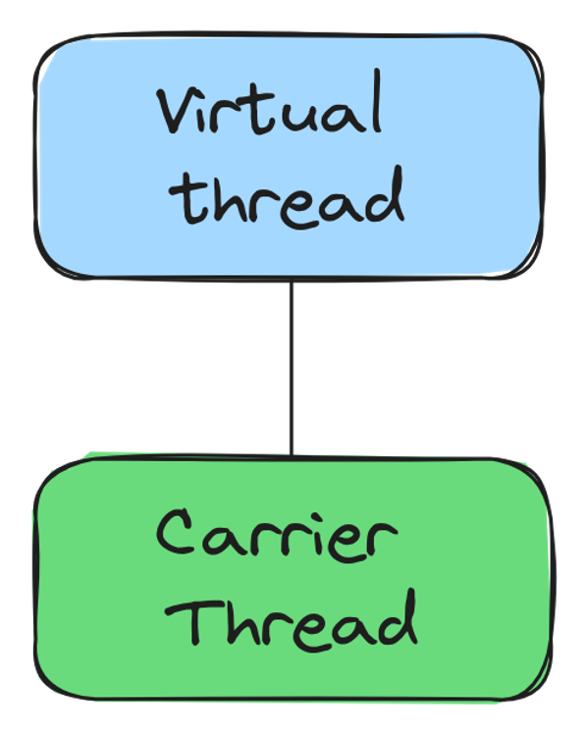
How does it work

Slide 15
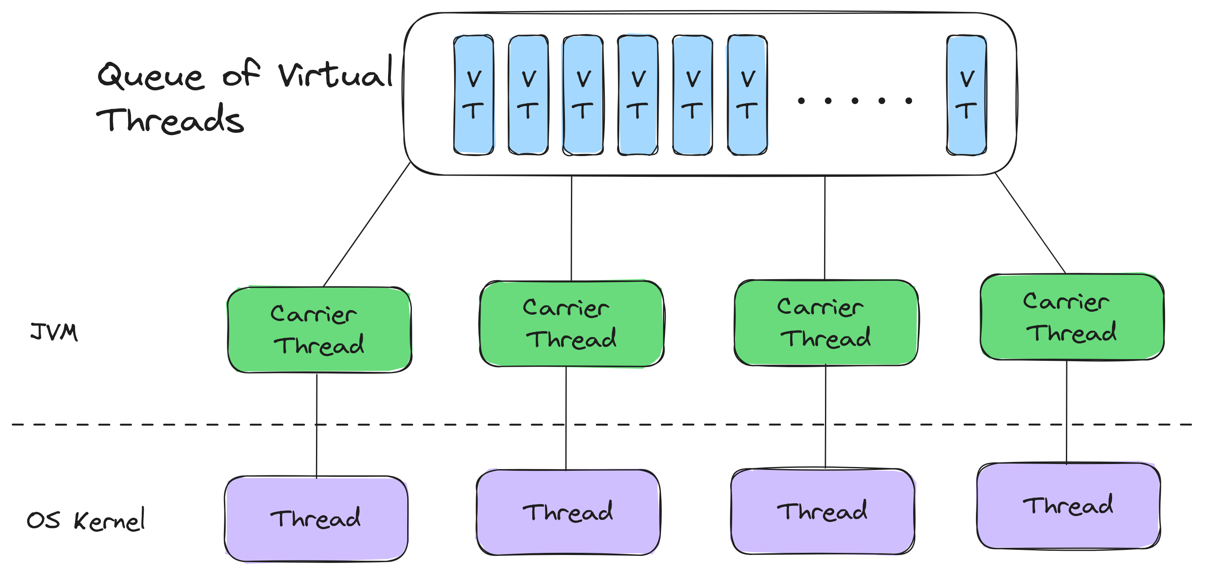
How does it work

Slide 16
Mounting and unmounting

Slide 17
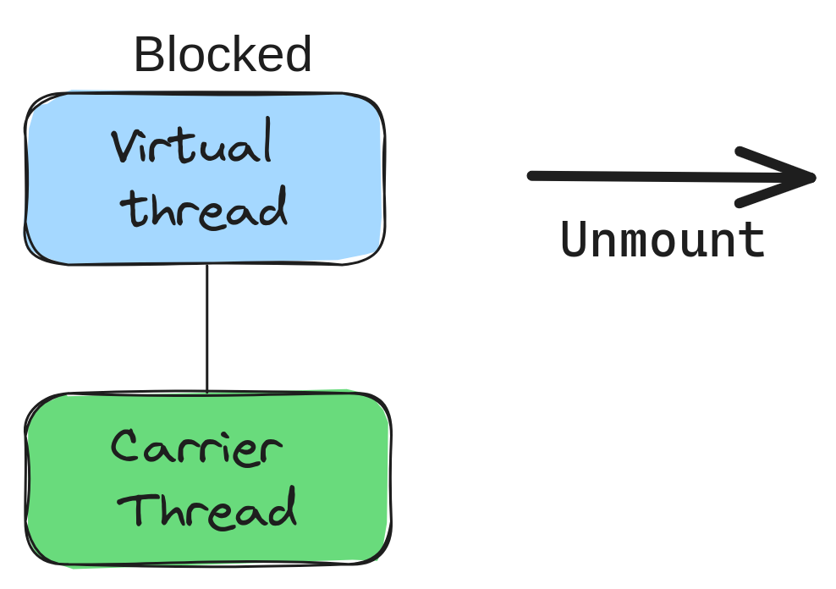
Mounting and unmounting

Slide 18
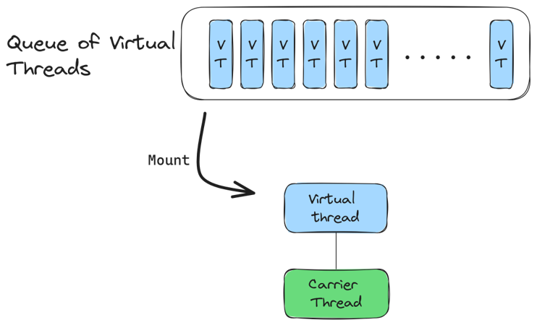
Mounting and unmounting

Slide 19
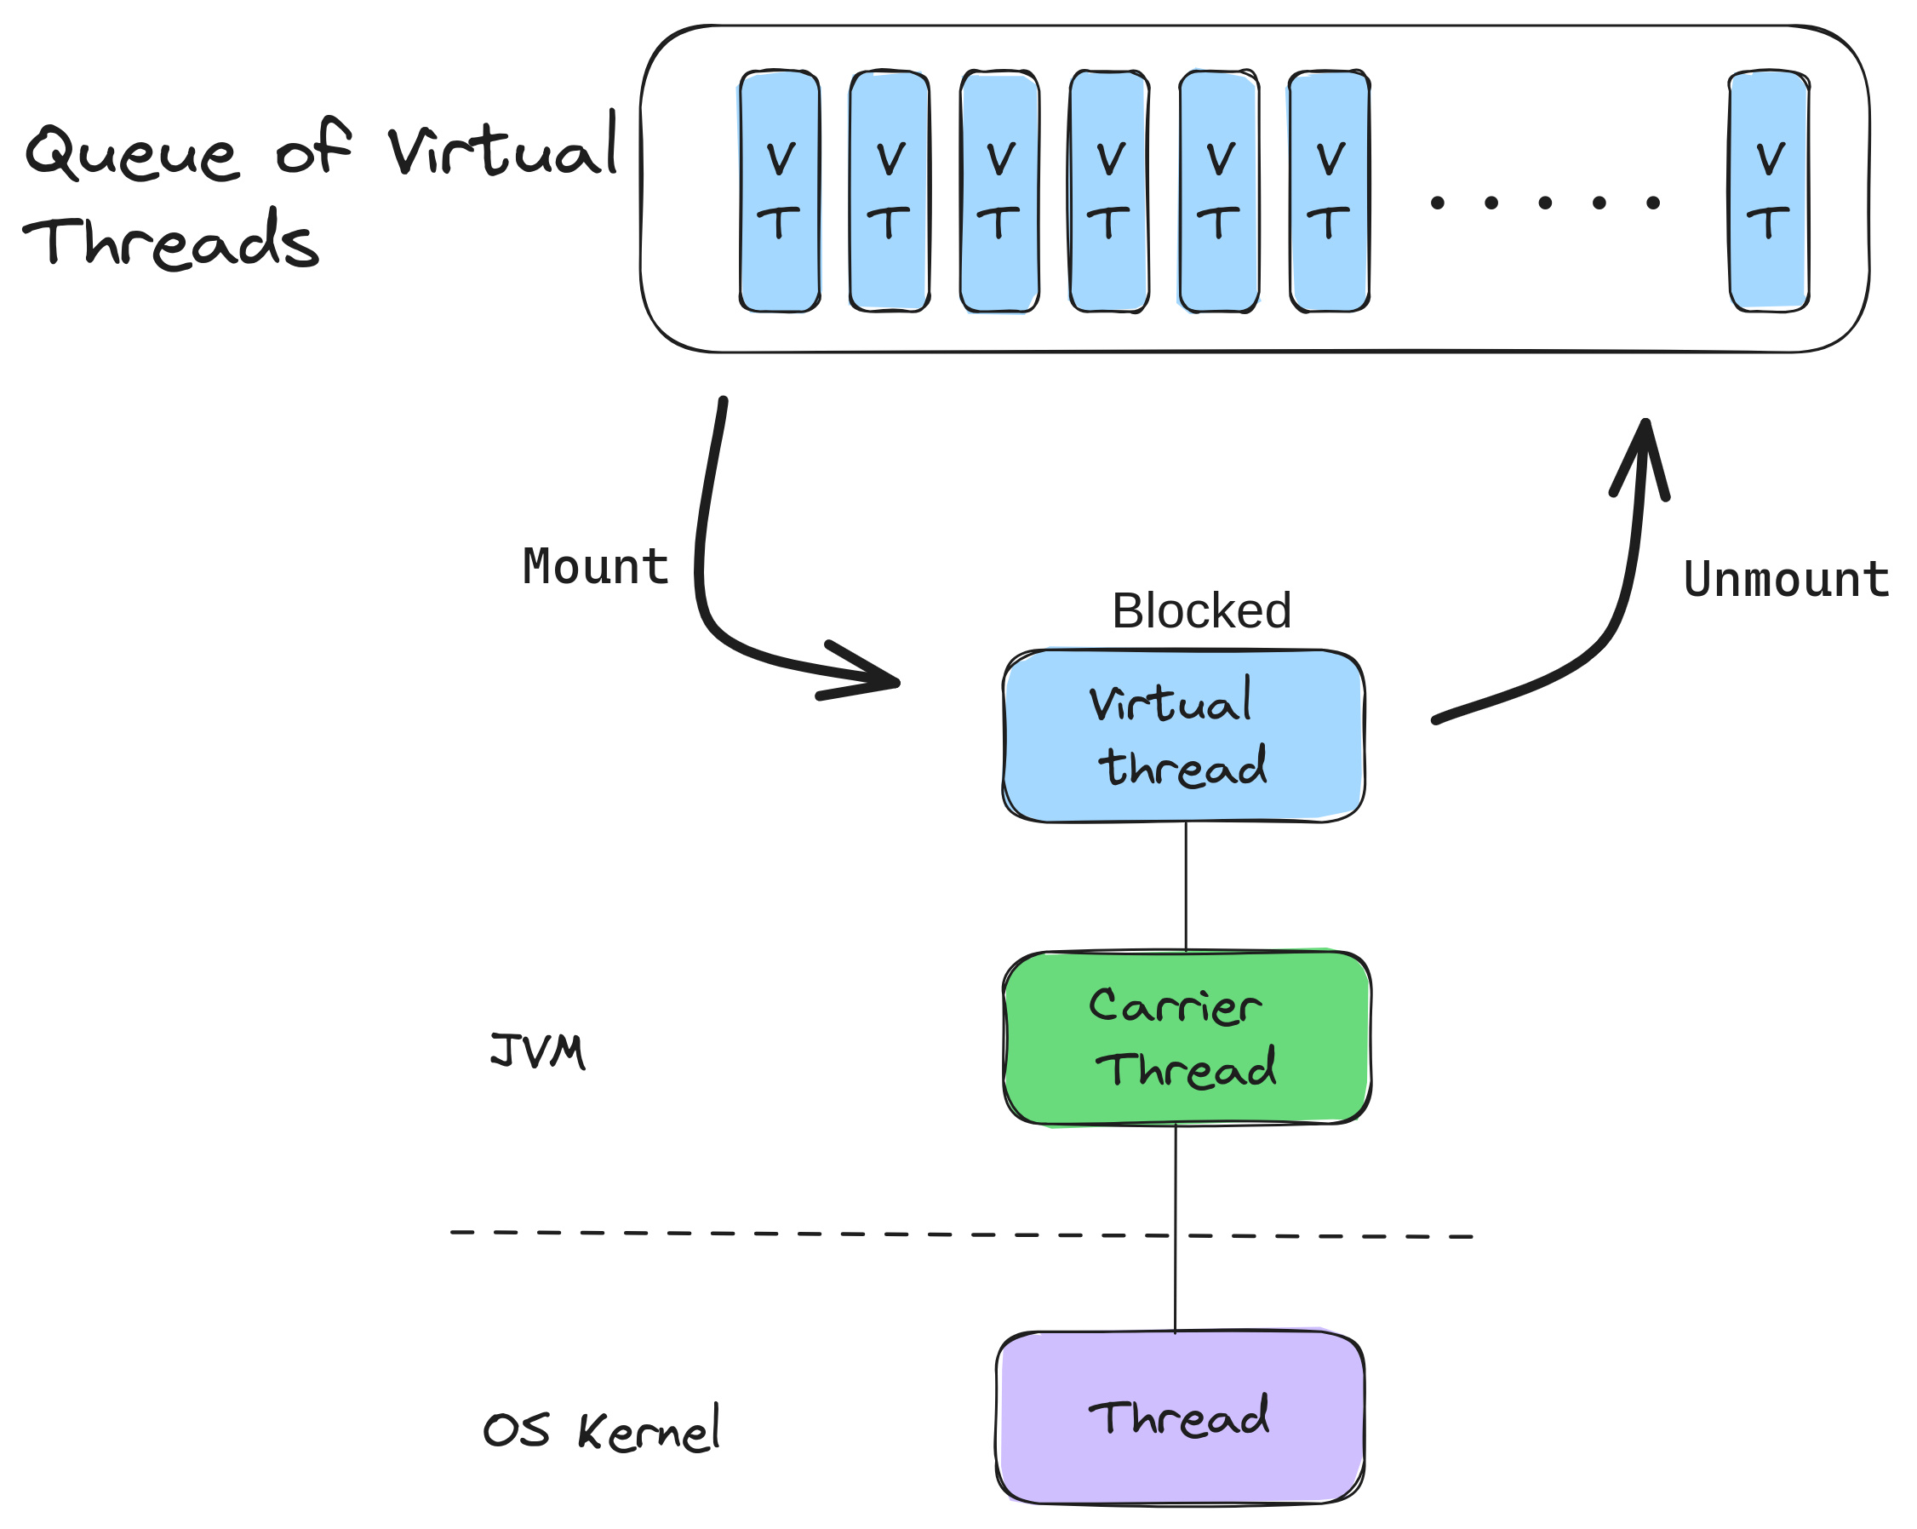
Mounting and unmounting

Slide 20
Time for step 4: Difference in threads

Slide 21
Pinning Virtual Threads

Slide 22
See pinned virtual threads
Run option:
-Djdk.tracePinnedThreads=short
System property:
jdk.tracePinnedThreads=full

Slide 23
Not every method is ready
Synchronized Block
Calls to native code (JNI)

Slide 24
Time for step 5: Find the pinned thread

Slide 25
Setting the number of carrier threads
-Djdk.virtualThreadScheduler.parallelism=1 Default of the number of carrier threads
-Djdk.virtualThreadScheduler.maxPoolSize=1 Maximum number of carrier threads

Slide 26
Time for step 6: Set the carrier threads

Slide 27
Time for step 7: Improve performance (it’s a setup for later)

Slide 28
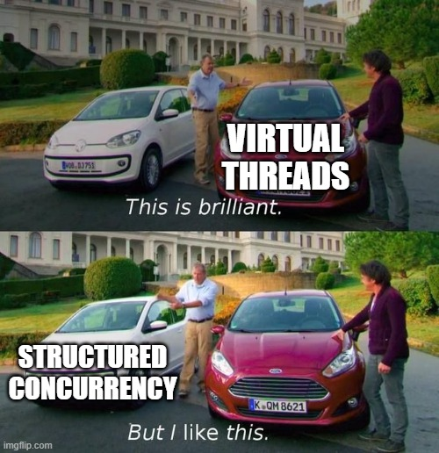

Slide 29
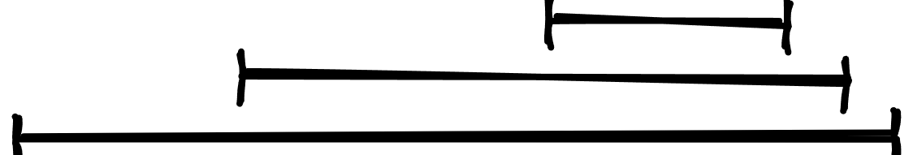
Structured concurrency

Slide 30
Structured Code
public String methodA(){ String foo = methodB(); String bar = methodC();
return foo + bar; }

Slide 31
Structured Code
public String methodA(){ String foo = methodB(); String bar = methodC();
return foo + bar; }
B
C
Result
A

Slide 32
Implicit relation
static public String methodA() throws … { Future<String> foo = methodB(); Future<String> bar = methodC(); return foo.get() + bar.get(); }
C
B
Result
A

Slide 33
Structured concurrency
try (var scope = new StructuredTaskScope.ShutdownOnFailure()) {
scope.fork(…)
}
try (… = new StructuredTaskScope.ShutdownOnSuccess<>()) {
scope.fork(…)
}

Slide 34
Time for step 8 & 9: Structured concurrency

Slide 35
What is a scoped value
A way to share data between threads
Use less memory than thread locals
Bounded context in which a value is known

Slide 36
Creating a Scope
class Scrape implements Runnable {
final static ScopedValue<HttpClient> CLIENT = ScopedValue.newInstance();
….
}

Slide 37
Creating a Scope
ScopedValue.runWhere(Scrape.CLIENT,
VALUE,
new Scrape(queue, visited))

Slide 38
Time for step 9: Creating a scope

Slide 39
Scope inheritance
Scoped values are inherited when using a StructuredTaskScope
When a scope is active all child threads will have the same scope
Hint: first create a scope with a given value

Slide 40
Bonus 1: Scope inheritance

Slide 41
Scope rebinding
It’s a child scope with the same key as the parent scope
Scope{ key1, value1…
Scope{ key1, value2…
Scope{key1, value3…

Slide 42
Bonus 2: Rebinding scopes

Slide 43
What does the taskscope do
Virtual threads behave as one unit of work
Passes down scope values
It stops Threads when a criteria is met

Slide 44
Creating your own taskscope
1. Extends the StructuredTaskScope<StartingPoint>
2. Override the handleComplete method
4. Check if the Status if the subtask is Subtask.State.SUCCESS
3. Call shutdown(); when you have the result you want

Slide 45
Bonus 3: Creating your own task scope

Slide 46
Moving logic out of the scope class
Freestyle assignment
You implement it any you want
It’s about improving the readability of your code
One suggestion: Try out the Predicate Functional interface

Slide 47
Bonus 4: Moving business logic

Slide 48
Deadlines
It stops virtual threads when they take to long
Creating a deadline:
.joinUntil();
What happens if a thread does not respond to interrupts? Maybe its stuck in a while(true)

Slide 49
Bonus 5: Deadlines

Slide 50
Virtual threads with existing executors
Virtual threads have their own factory
Thread.ofVirtual().factory();
Use this factory so other executors use virtual threads instead of platform threads

Slide 51
Bonus 6: Virtual threads with executors

Slide 52
Limiting the number of requests without pools
Freestyle challenge to limit the number of requests made.
Suggestion: A Semaphore is one way of solving this
Side note: You cannot create a pool of virtual thread, or pin a thread in any way

Slide 53
Bonus 7: Limit the number of requests

Slide 54
Someone want to show their Scraper, or freestyle assignment?

